Slide 1

Deep learning model in analysing the Genetic variation associated with the occurrence and progression of Neurodevelopmental disorders
Project Proposal

Slide 2
SCOPE:
To identify and predict the genomic variations among children in the following neurodevelopmental disorders using deep learning model
Duchenne muscular dystrophy
Cerebral palsy
Autism
ADHD
the effective development of deep learning model helps to the early detection of embryonic neurodevelopmental disorders (ENDs) based on its prognostic values could render quality diagnosis and health management

Slide 3
Team Members
COMPUTER SCIENCE | LIFE SCIENCE
Dr. S. Pitchumani Angayarkanni Associate Professor, Department of Computer Science Lady Doak College | Dr. S. Kalaivani Priyadarshini, Assistant Professor, Department of Biotechnology, Lady Doak College
Dr. Sofia, Associate Professor, Department of Computer Science, Lady Doak College. | Ms. Raga Priya UG Student Bioinformatics TN Agricultural university. Coimbatore

Slide 4
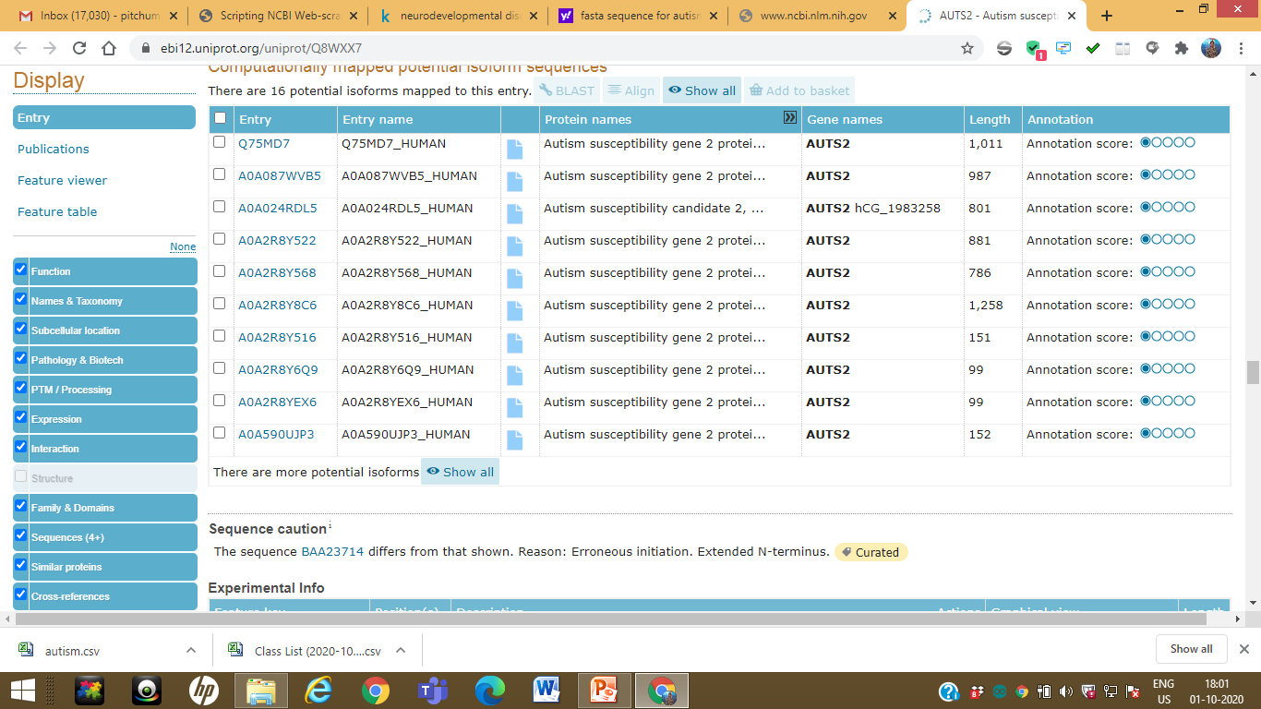
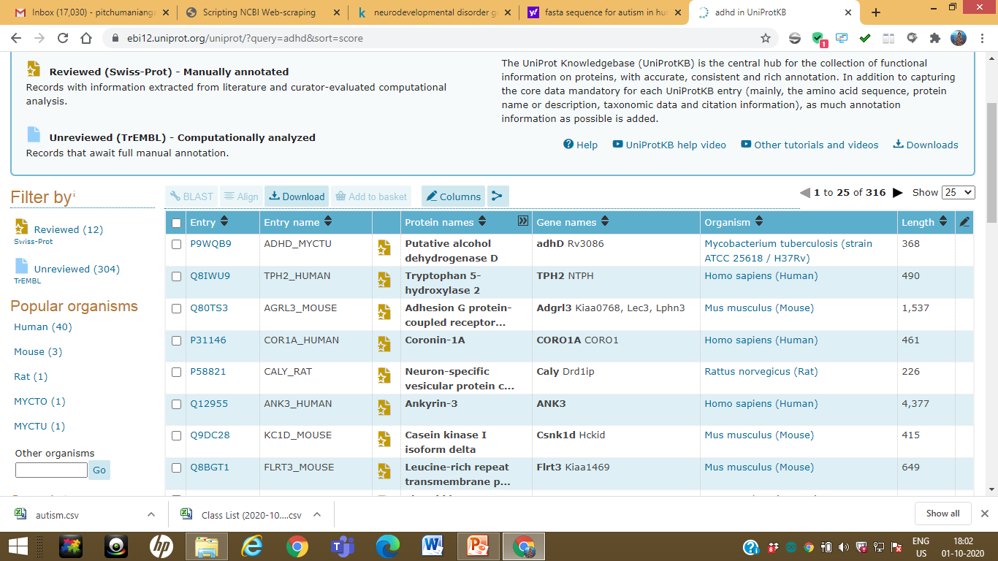
https://ebi12.uniprot.org/uniprot/?query=adhd&sort=score

Slide 5
Dataset Preparation
Biopython and Entrez search tools
Manual Dataset - NCBI
Web scrapping Technique
Validate – Compare the Similarities and fetch similar rows
csv_merge with class label
To find sequence Similarity
(Compare Clustalw and developed Deep Learning Algorithm)
Remove the records with null genomic_nucleotide_accession.version

Slide 6
Final Dataset
Neurodevelopmental Disorder | Manual Dataset- NCBI | Web Scrapping | After Preprocessing
ADHD | 172 | 180 | 166
AUTISM | 37 | 40 | 37
Cerebral Palsy | 51 | 60 | 50
Muscular Distrophy | 63 | 62 | 63
 |  | Total | 316

Slide 7
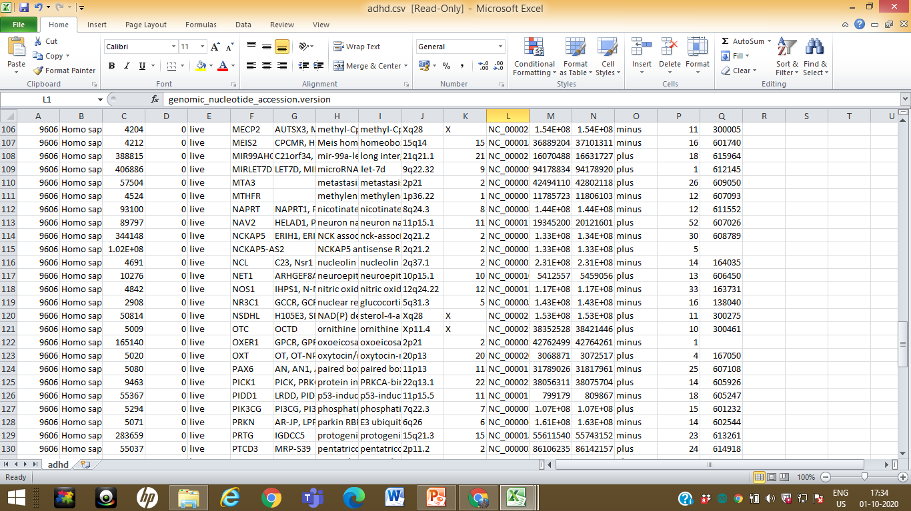

Slide 8
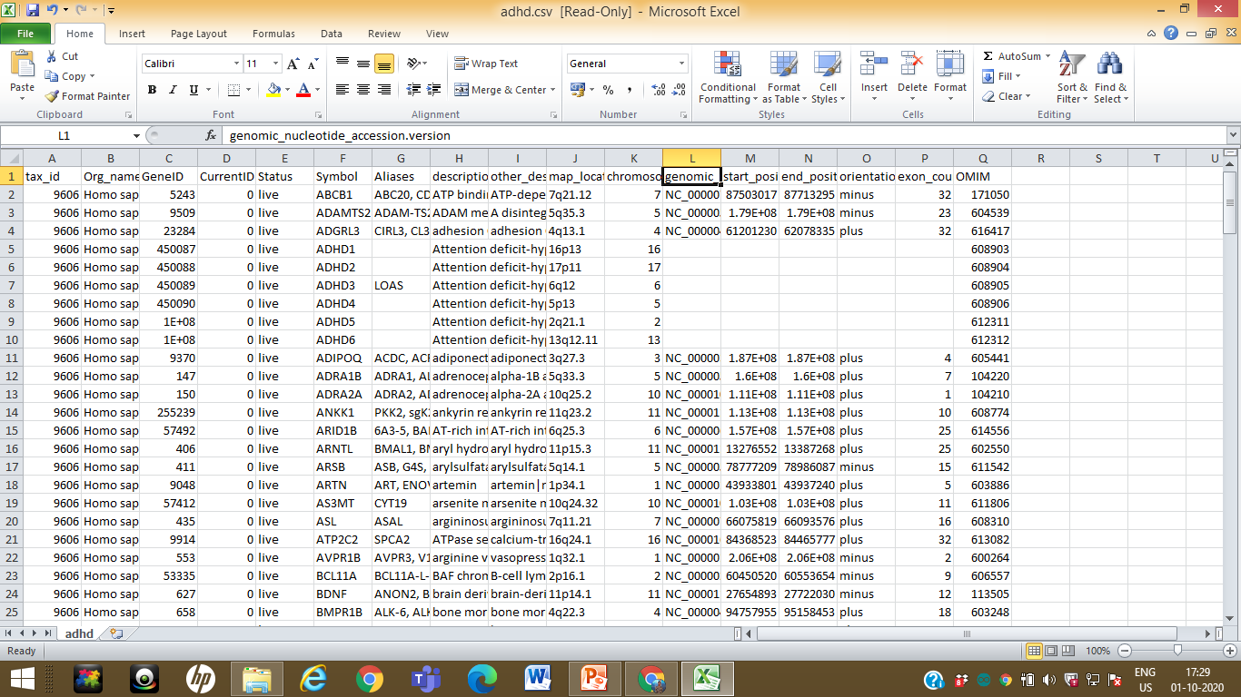

Slide 9
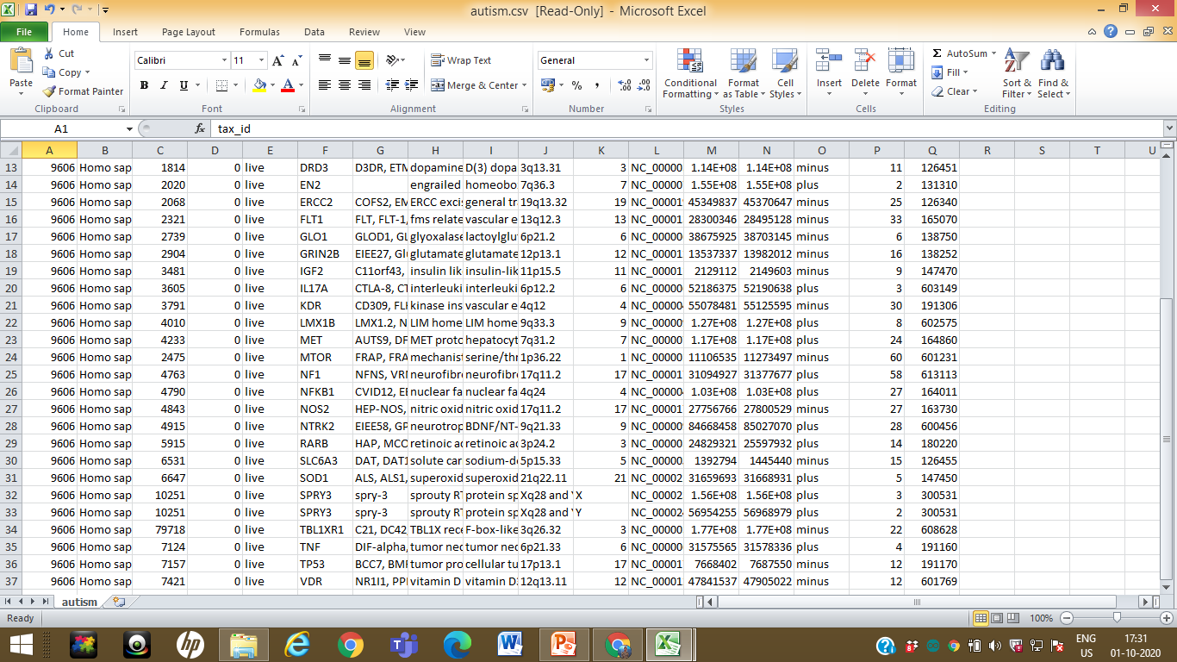

Slide 10
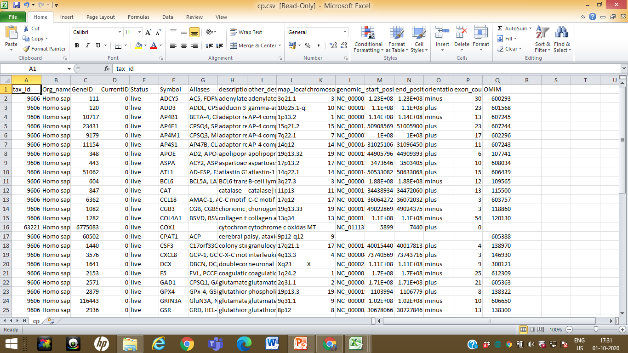

Slide 11
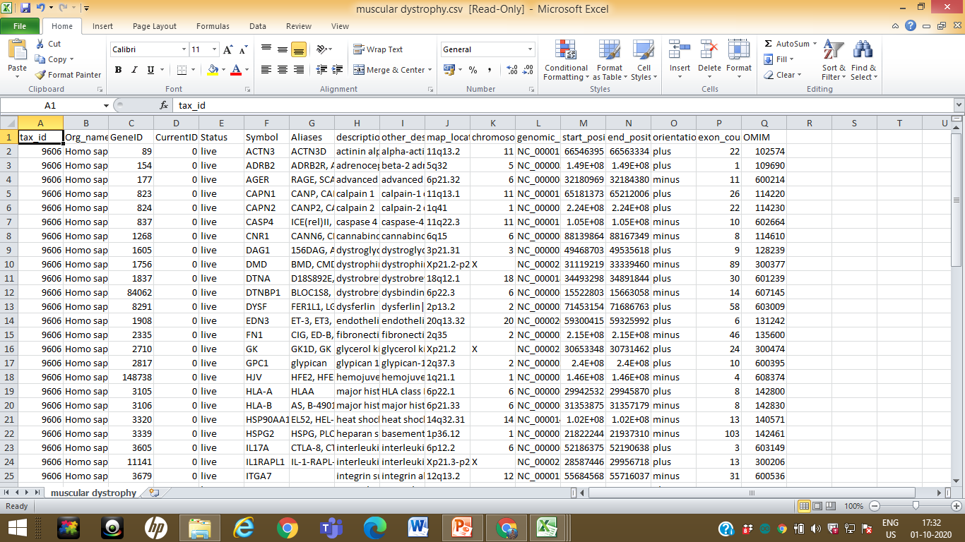

Slide 12
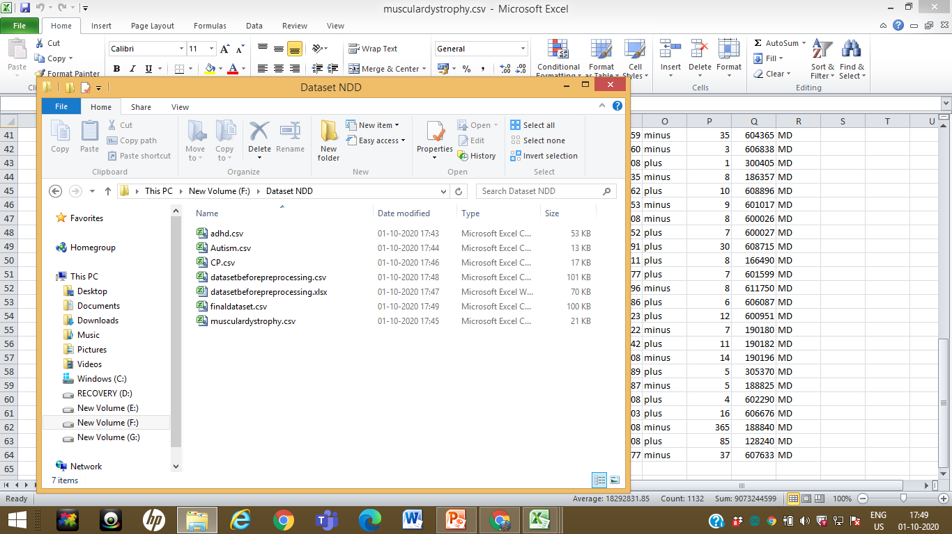

Slide 13
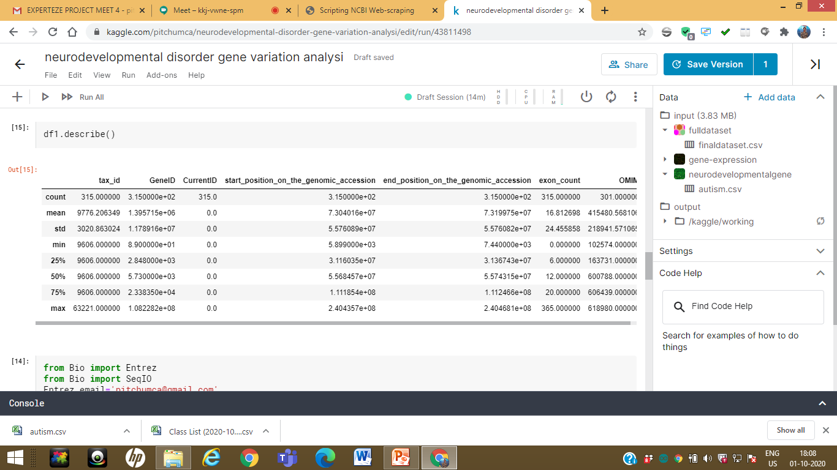

Slide 14
https://www.frontiersin.org/articles/10.3389/fpsyt.2016.00142/full
https://gene.sfari.org/database/human-gene/AUTS2

Slide 15
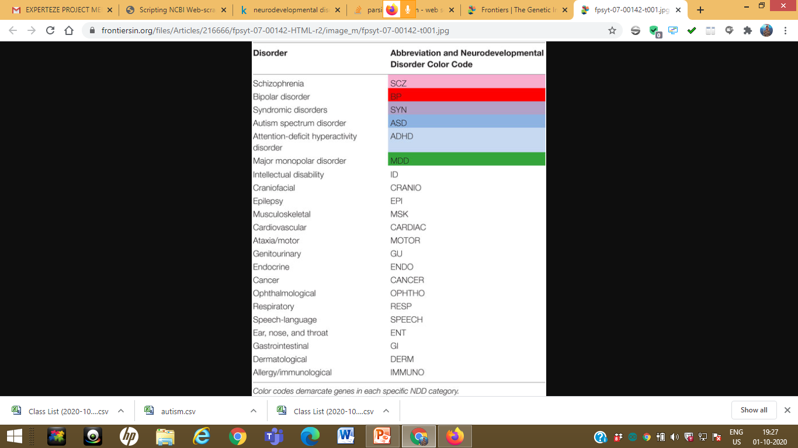

Slide 16
Footnotes
^http://www.nimh.nih.gov/health/statistics/index.shtml
^http://adhd.psych.ac.cn/topGene.do
^https://gene.sfari.org/autdb/GS_Home.do
^http://bdgene.psych.ac.cn/topGene.do
^http://www.psygenet.org/
^http://www.omim.org
^http://uswest.ensembl.org/biomart/martview/5c4ed4a0df8a4edd185363c07c92e0ce

Slide 17
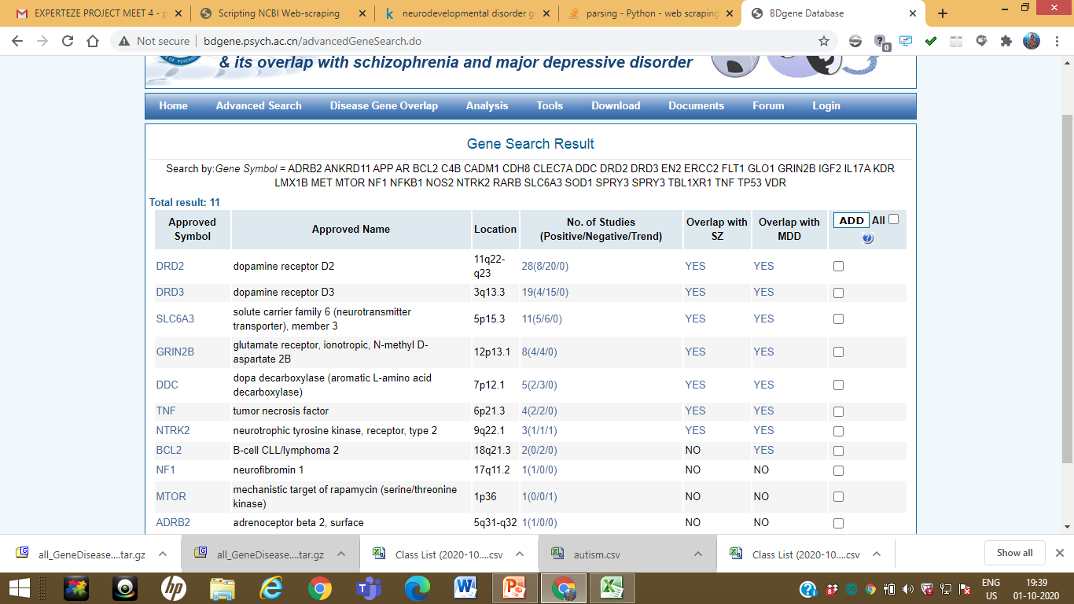
http://bdgene.psych.ac.cn/advancedGeneSearch.do

Slide 18
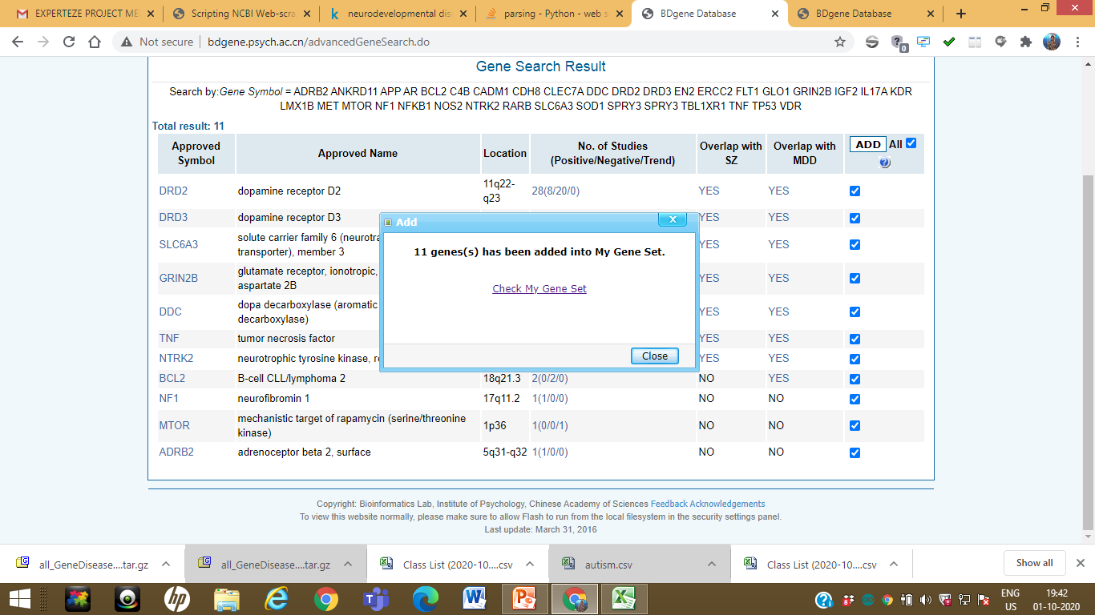

Slide 19
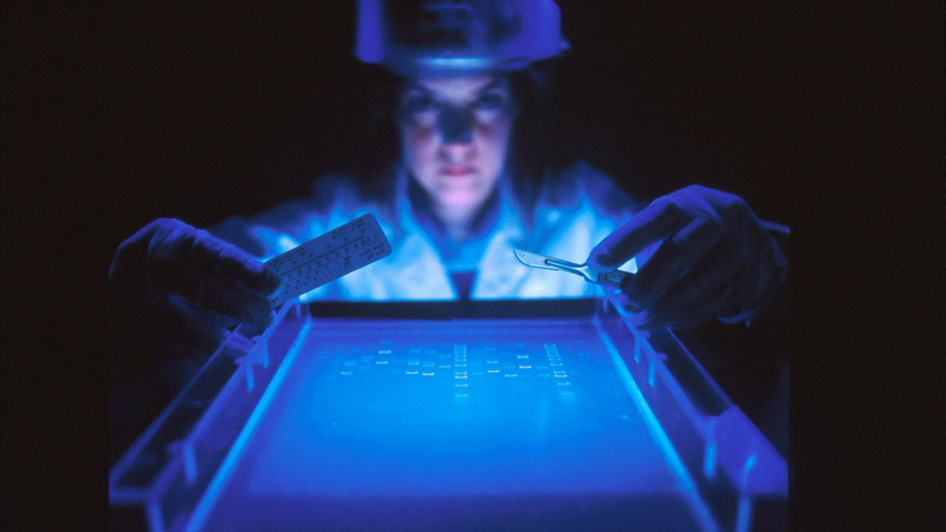
THANK YOU

